Slide 1

BRITISH AIRWAYS DATA SCIENCE VIRTUAL PROGRAM
CUSTOMER AIRLINE REVIEW ANALYSIS

Slide 2
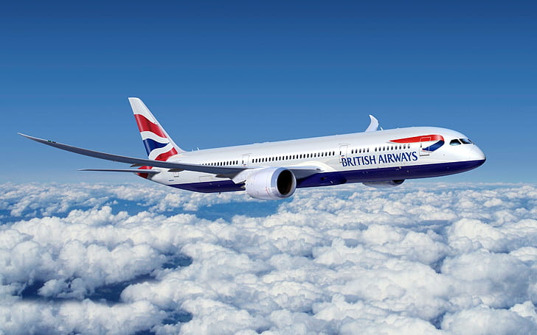
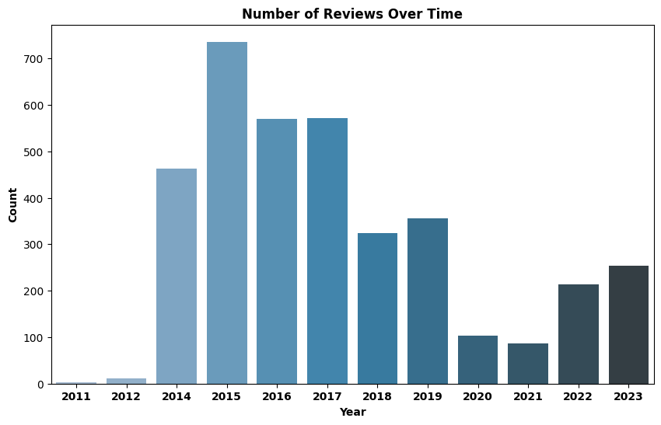
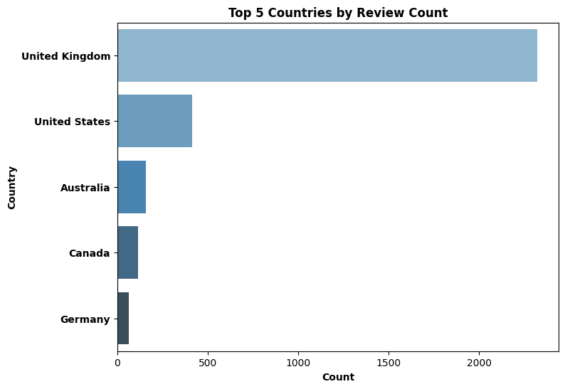
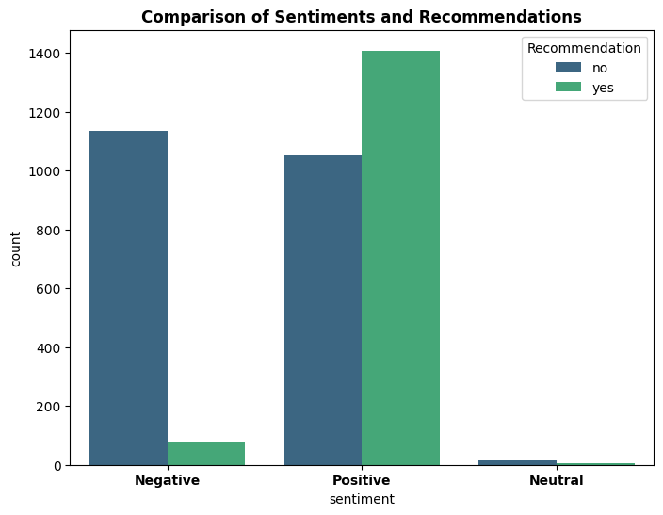
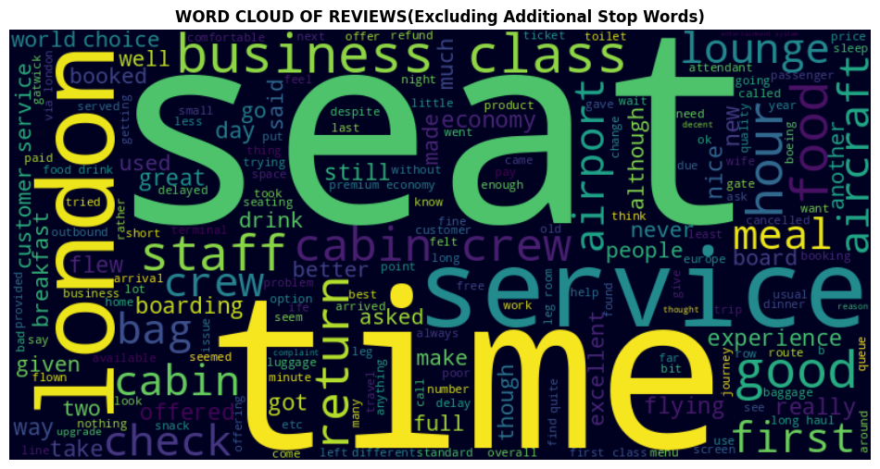
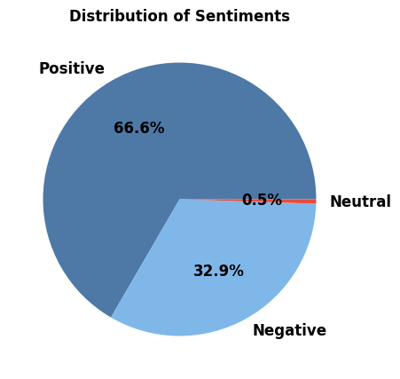


BRITISH AIRLINE REVIEW ANALYSIS
The analysis indicates that customer reviews encompass various aspects of the flight experience.
Positive Aspects based on sentiment score of words: Excellent: 0.26, Nice: 0.20, Friendly: 0.19, Comfortable: 0.15, Lounge: 0.15, Drinks: 0.14, Cabin: 0.12, Crew: 0.15
Areas of Concern: Poor: 0.02, Customer: 0.02, Delayed: 0.04, Due: 0.06, Old: 0.06, Last: 0.06, Two: 0.07, and Luggage: 0.07.
Addressing concerns related to delays, luggage, and overall customer service is crucial for enhancing the overall travel experience and customer satisfaction.
Importantly, many positive reviews do not result in recommendations, emphasizing the need to align with customer expectations for a more recommendable experience.
Link to code on Google Colab : Link
INSIGHTS FROM ANALYSIS
Total Reviews
3694
Country Count
73
Recommended Ratio: 40.4%
Positive Sentiment score : 66.6%

